Slide 1

Public Cloud Security Project
Jigar N Kapasi
Nagesh Ramamoorthy
Naman Bhatt

Slide 2
Agenda
Project Overview
AWS Solution
Demo
Scope
Design Principles
Component Diagram
CIS controls and Benchmarks
MVPs
MVP1 Scope and Value adds
AWS SecurityHub Intro
Detailed Designs
Cost Analysis
Multi account , Multi- region Use case
Deployment
Dashboards
Integration options

Slide 3


Project Overview

Slide 4
Scope
Cloud platform security
OS and Middleware security
*Cloud IAM , *Object / Block Storage , *VPC , *Security Groups, *VMs, *Logging, *Monitoring , *PaaS services etc.
*Security of OS platforms such as Windows/Linux OS/AIX
*Security of Middleware platforms hosted on OS *No different from Hybrid Environment.

Slide 5
Secure – Data at rest and in transit
Least privileged access
Durable - Data
Highly Available - Services
Cost effective – One of the most important
Loosely coupled – Microservices approach
Compliance to Global Framework
Ease of Use and deployment – From the delivery perspective
Cloud Native
Cross Cloud Framework adoption (Ansible cloud modules)
Infrastructure as Code ( IaC)
Zero touch – End to end Automation
Design Principles

Slide 6





Component diagram
CIS Benchmark | GTS controls
Auditing (Scanning)
ServiceNow
Alerting
Auditing / Remediation:
Cloud Native tools
CLI / Python
Ansible Playbooks
Remediation
Alerting to be integrated from the cloud native alerting system to Netcool system
Each module is loosely coupled. The module can be native , third party , custom developed or Hybrid.
Cloud Native based solution to be preferred

Slide 7
Design Notes:
The priority of the clouds is as follows: IBM Cloud , AWS, Azure, GCP and Ali Cloud.
The automation solution would support two standards viz., CIS benchmark and GTS custom standard based on CIS standard.
Currently only AWS, Azure and GCP clouds have availability of CIS benchmark specifications.
The Global GTS security team has defined custom security standard only for AWS and Azure clouds as on today.
Our first and preferred approach for auditing and remediation is through Cloud native services where possible. The second preferred method would be through Ansible playbooks.
The automation module must be loosely coupled so that the cloud native, ansible or custom developed modules can be integrated differently according to use cases.
The detailed design would follow the defined design principles.

Slide 8
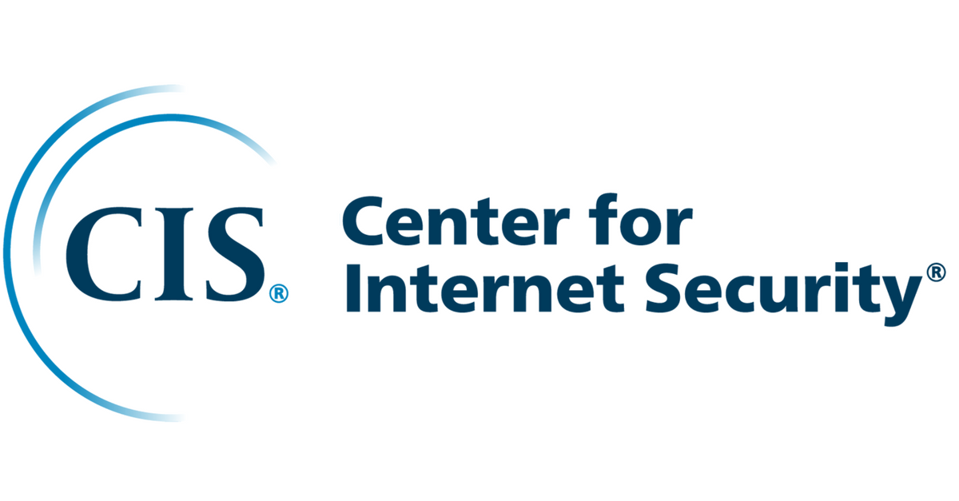
CIS Controls and Benchmarks
CIS (Center for Internet Security) is a community-driven nonprofit, responsible for the CIS Controls and CIS Benchmarks, globally recognized best practices for securing IT systems and data.
The CIS Controls are a general set of recommended practices for securing a wide range of systems and devices, whereas CIS Benchmarks are guidelines for hardening specific operating systems, middleware, software applications, and network devices.
CIS Benchmarks are developed through the consensus based generous volunteer efforts of subject matter experts, technology vendors, public and private community members, Secure Suite members and the CIS Benchmark Development team. Eg. IBM Cloud CIS benchmarks are being developed in similar method

Slide 9
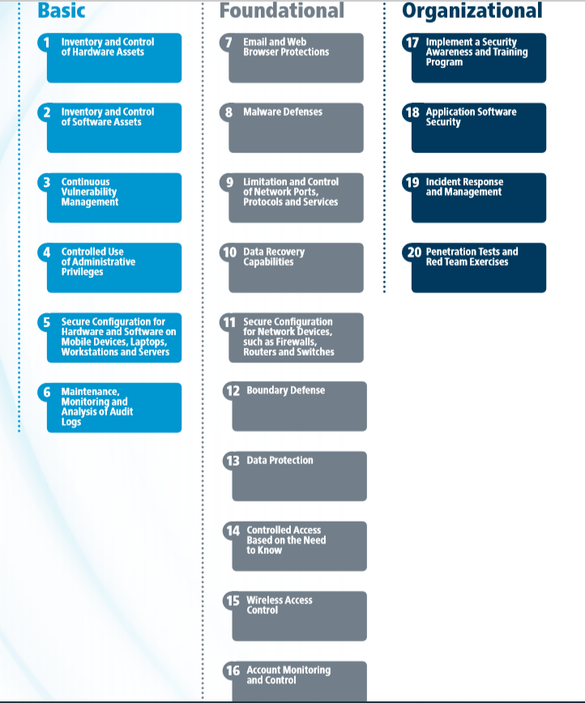
CIS Controls
V7.1 Apr 2019
There is an exclusive deep dive session recording available on CIS

Slide 10
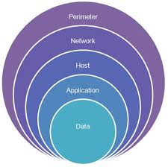
Profiles and Scoring status
Most CIS Benchmarks include multiple configuration profiles.
The Level 1 profile is considered a base recommendation that can be implemented fairly promptly and is designed to not have an extensive performance impact.
The Level 2 profile is considered to be "defense in depth" and is intended for environments where security is paramount.
Scoring: Each recommendation in a benchmark is marked as either “scored” or “not scored” based on whether it can be programmatically tested

Slide 11
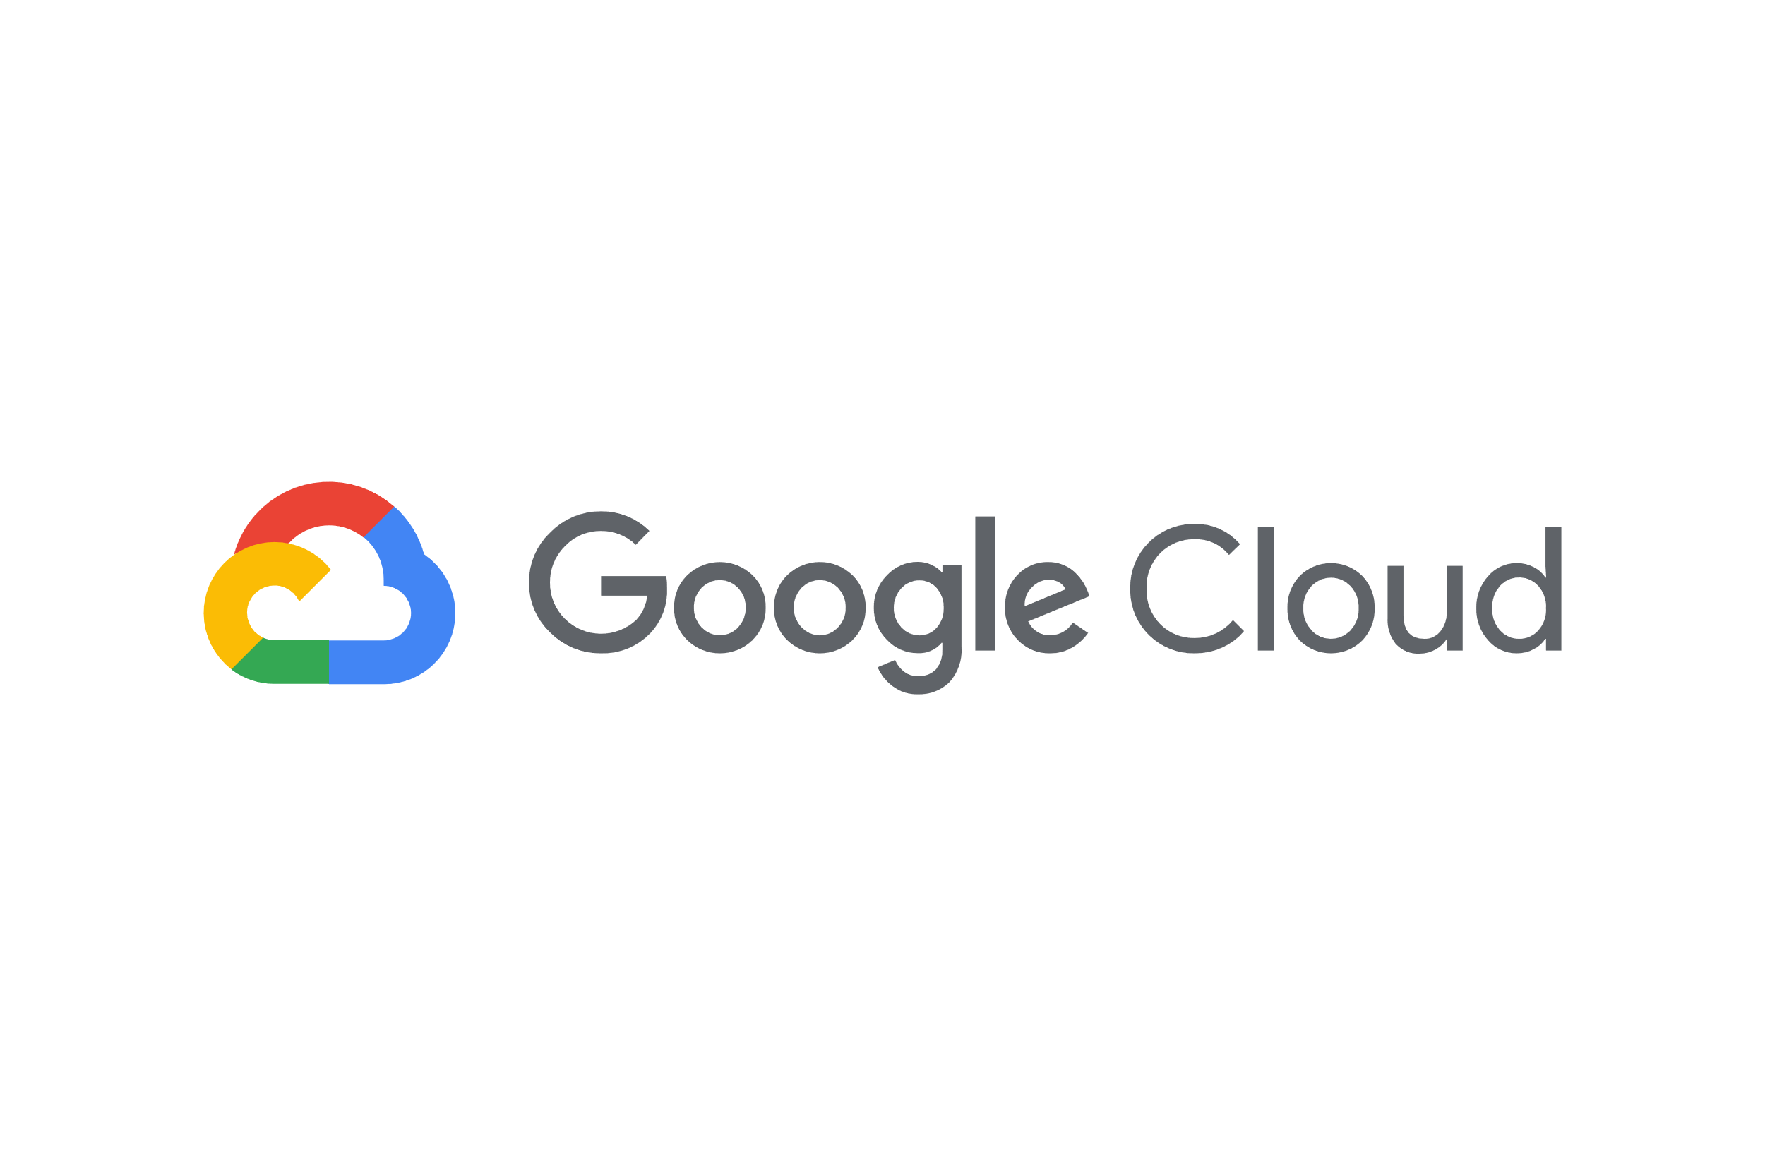


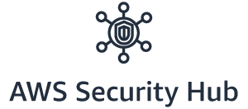


CIS Benchmark comparison - Overview
Benchmark Latest version : 1.2.0 (1.3.0 draft)
MCMS supported: 1.2.0
No. Sections : 4
No of Recommendations : 49
Supported Native Tool :
Tool Coverage of Benchmark : 88% (43/49)
Benchmark Latest version : 1.1.0 (1.2.0 draft)
MCMS supported: 1.1.0
No. Sections : 9
No of Recommendations : 111
Supported Native Tool: Azure Security Center* Tool Coverage of Benchmark : 55% (61/111)
Benchmark Latest version : 1.1.0 (1.2.0 draft)
MCMS supported: 1.0.0
No. Sections : 7
No of Recommendations : 64
Supported Native Tool: GCP Security Command Center Tool Coverage of Benchmark : 92% (59/64)
*Still under evaluation

Slide 12
CIS Benchmark comparison - Detailed
49 recommendations
111 recommendations
64 recommendations
Section 1 : IAM Recommendations : 22
Level1 : 20 ( 4 not scored) | Level2 : 2 (1 not scored)
Section 1 : IAM Recommendations : 23
Level1 : 8 ( 7 not scored) | Level2 : 15 (14 not scored)
Section 1 : IAM Recommendations : 13
Level1 : 10 ( 3 not scored) | Level2 : 3 (2 not scored)
Section 2 : Logging Recommendations : 9
Level1 : 5 | Level2 : 4
Section 2 : Security Center Recommendations : 19
Level1 : 17 | Level2 : 2
Section 2 : Logging & Monitoring Recommendations : 11
Level1 : 11 | Level2 : 0
Section 3 : Monitoring Recommendations : 14
Level1 : 9 | Level2 : 5
Section 3 : Storage accounts Recommendations : 8
Level1 : 5 ( 3 not scored) | Level2 : 3 (2 not scored)
Section 3 : Networking Recommendations : 9
Level1 : 6 (3 not scored) | Level2 : 3
Section 4 : Database Services Recommendations : 19
Level1 : 14 | Level2 : 5
Section 4 : Virtual Machines Recommendations : 6
Level1 : 5 (1 not scored) | Level2 : 1
Section 4 : Networking Recommendations : 4
Level1 : 2 | Level2 : 2 (1 not scored)
Section 5 : Monitoring & Logging Recommendations : 16
Level1 : 15 | Level2 : 1
Section 5 : Storage Recommendations : 3
Level1 : 3 (1 not scored) | Level2 : 0
Section 6 : Networking Recommendations : 5
Level1 : 4 | Level2 : 1
Section 6 : Cloud SQL Databases Recommendations : 4
Level1 : 4 | Level2 : 0
Section 7 : Virtual Machines Recommendations : 6
Level1 : 6 (3 not scored) | Level 2: 0
Section 7 : Kubernetes Engine Recommendations : 18
Level1 : 16 (2 not scored) | Level2 : 2 (1 not scored)
Section 8 : Others Recommendations : 5
Level1 : 4 | Level2: 1 ( 1 not scored)
Section 9 : App Service Recommendations : 10
Level1 : 10 (5 not scored) | Level2: 0

Slide 13
Availability of standards
Cloud | CIS | GTS Custom
AWS | Yes | Yes
Azure | Yes | Yes
GCP | Yes | No
IBM Cloud | No | No
Ali | No | No
(GTS SRRM)

Slide 14
MCMS Public Security automation – MVPs
MVP1
MVP2
MVP3
MVP4
Goal: Cloud native way of auditing security standard on major cloud platforms.
Standards in Scope: CIS benchmarks
Clouds in scope: AWS , Azure , GCP, IBM Cloud AWS
A. Leverage cloud config native tool to perform auditing againstt each of the controls in CIS benchmark.
B. Leverage AWS security Hub native tool to perform auditing , filtering, aggregation and prioritize the security findings from multiple AWS accounts and create usable dashboards for multi-account visibility.
Azure A. Leverage Azure policies to audit and enforce the CIS benchmark controls for Azure.
B. Leverage Azure security center to audit , filter , aggregate security findings and create multi-subscription dashboards for the visibility
GCP
Leverage GCP’s organizational policies to audit security controls
Leverage Security command center to audit , filter, aggregate findings and create usable dashboards.
IBM Cloud Explore the IBM Cloud native services and its capabilities as is today to audit the security findings and initiate the dialogue with IBM cloud product team for the roadmap
Goal: Cloud native way of auditing security standards and integrate with MCMS standard Event management and ticketing system
Standards in Scope: CIS benchmark
Clouds in Scope: AWS, Azure, GCP
AWS: Any new findings detected through cloud config or security hub should sent to MCMS Netcool servers using AWS native SNS service and other custom integration methods.
Azure: Any new findings through Azure security center and /or azure policies should be sent to MCMS Netcool servers using Azure activity log , event grid such native services and other custom integration methods.
GCP: Any new findings through GCP policies or security command center should be sent to MCMS Netcool servers using GCP native services(cloud pub/sub) and other custom integration methods.
Netcool Integration Payload and severity: Definee an uniform payload for the findings across clouds and severity levels for each control for the ticket creation.
Goal: Cloud native way of auditing security controls and ansible playbooks to remediate the findings where cloud native not possible.
Standards in Scope: CIS benchmark
Clouds in Scope: AWS, Azure, GCP
AWS : Integrate ansible based remediation module with cloud native services like AWS config or security hub and the ability to trigger manually by the SRE team
Azure: Integrate ansible based remediation module with cloud native auditing services like Azure policies or security center and the ability to trigger manually by the SRE team.
GCP: Integrate ansible based remediation module with cloud native auditing services like GCP policies or security command center and the ability to trigger manually by the SRE team.
Continuous compliance: Develop MCMS public cloud point of view on CC , define the CC objectives and implement across AWS, Azure, GCP clouds
Goal : Support more cloud platforms and security standards for the auditing , remediation and alerting systems.
Standards in scope: CIS benchmark, GTS custom security standards.
Clouds in Scope: IBM Cloud, AWS, Azure, GCP and Ali Cloud.
IBM Cloud : A. Liaise with GTS security team and develop the security standard for IBM Cloud.
B. Leverage IBM Cloud native tools to perform the auditing.
Ali Cloud:
Liaise with GTS security team and develop the security standard for Ali Cloud.
Leverage Ali Cloud native tools to perform the auditing
GCP: Liaise with GTS security team and develop the security standard for GCP
AWS/Azure: Perform auditing support for the GTS custom standard controls.

Slide 15

AWS Solution

Slide 16
Scope and Value Additions
MVP1 Scope
Scan Cloud services and resources against CIS benchmark for AWS using Cloud native tool on the most MCMS customer use cases
Forward the deviations / findings with Cloud native monitoring / logging system
Value Adds
View the deviations / findings in the cloud native dashboard , optionally download the report in csv / pdf format.
Being able to further integrate with external monitoring systems and optionally view the findings /deviations from the cloud native system.
Roadmap for future MVPs
IaC , GitOps , Ansible tower Integration , Deviation Remediation , SNOW integration , ECM integration, third party tools integration , support for GTS custom standard, Ali and IBM Cloud support etc

Slide 17

AWS Security Hub Overview
Generally available since June 2019
AWS Security Hub is a regional service.
Available in 19 regions
There is a free trial of 30 days for Security Hub
Security Hub is SOC, ISO, PCI, and HIPAA certified
Security Hub is integrated with cloudTrail and cloudwatch.
When we enable security hub in a given region, it automatically starts reading the findings from the AWS services and optionally we can enable industry standards like CIS and PCI DSS
Security Hub is a multi-tenant service offering. To ensure data protection, Security Hub encrypts data at rest and data in transit between component services

Slide 18
Core Features
Receive the security findings input from various security services of AWS account(s)
Receive and/or send security findings from third party providers like Qradar
Check for compliance of industry standard controls like CIS benchmark and PCI DSS and generate security findings if required
Tight Integration with CloudWatch and CloudTrail native services for Alerting and Logging

Slide 19


Multi-Account structure
There is an exclusive deep dive session recording available on Security Hub service
Member Account
Master Account
Member Account
Master Account
If your invitations are accepted by a member account , your account is designated as the Security Hub master account
Member Account
Added accounts are member accounts. With the master account, you can view findings in member accounts

Slide 20
MCMS Customer Use Cases
Use case | Deployment Scenario | Description
Use Case 1 | Single Region | MCMS customer with workloads on a singe account , and singe region environment
Use Case 2 | Multi-Region | MCMS customer with workloads on a Single account but multi-region environment
Use Case 3 | Multi-Account , Multi-Region | MCMS customer with workloads in Multi-Account and multi-region deployment

Slide 21
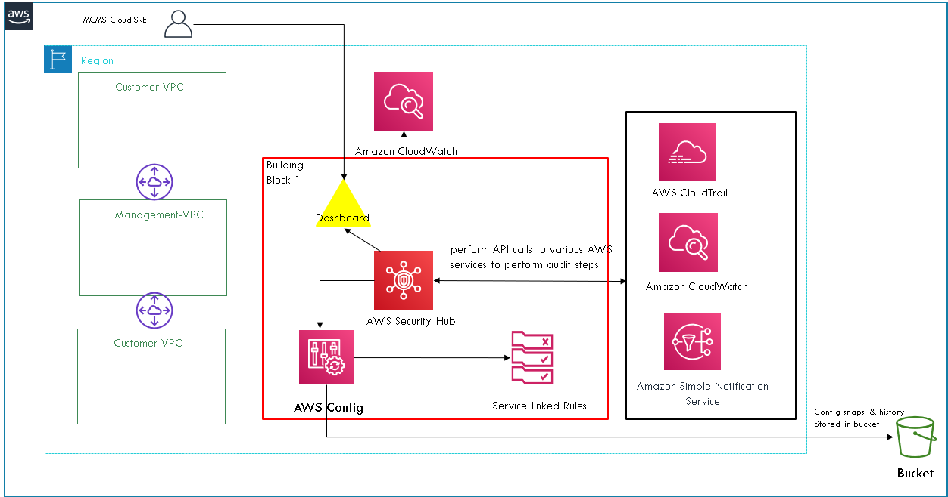
Use Case 1 : Single Region Deployment

Slide 22
Single Region Deployment
AWS security HUB is a Regional service.
To run security checks on your environment's resources, AWS Security Hub either uses audit steps specified by the standard, or uses specific AWS Config managed rules
Once we enable a security standard, Security Hub automatically creates the AWS Config service-linked rules that it needs to run checks against the enabled controls.
Aws config scope should be set to global. To enable monitoring of global resources.
When a specific control in a security standard is disabled , the related AWS Config rules that Security Hub created are removed

Slide 23
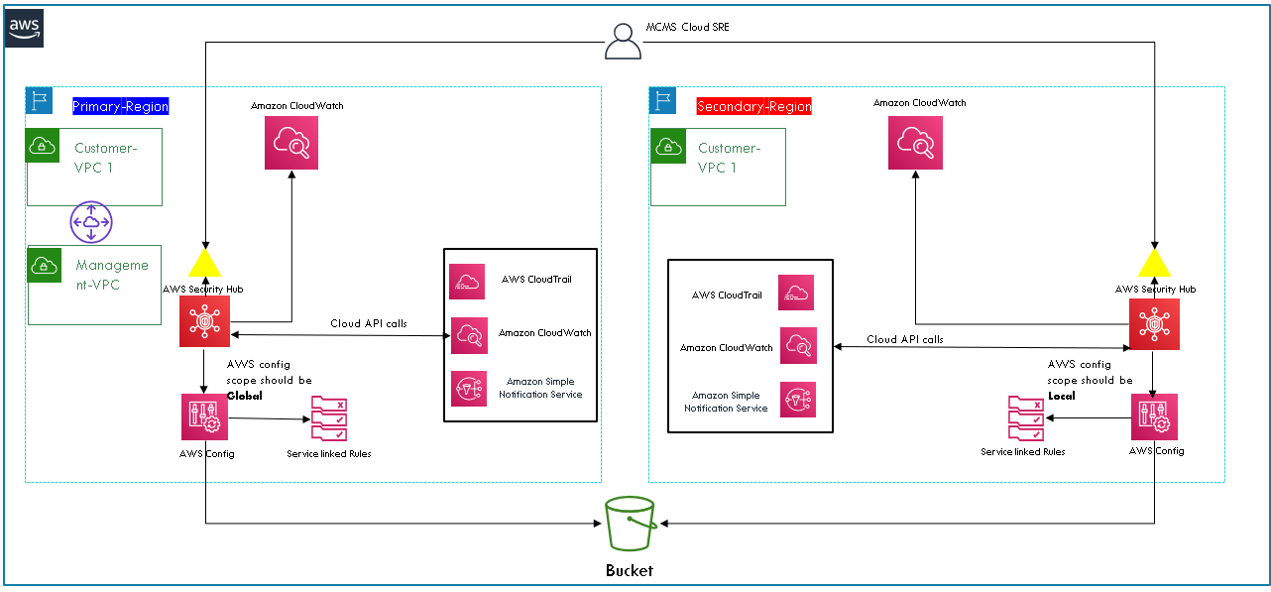
Use Case 2: Multi-Region Deployment

Slide 24
Multi-Region Deployment
Ensure Security HUB is enabled on all in-use regions.
Note- Security Hub is a regional service
Aws config in primary region should have global scope. To be able to probe global resources and validate compliance.
Secondary region
1- should have local scope in aws config.
2- Certain controls can/should be disabled .( refer solution doc)

Slide 25
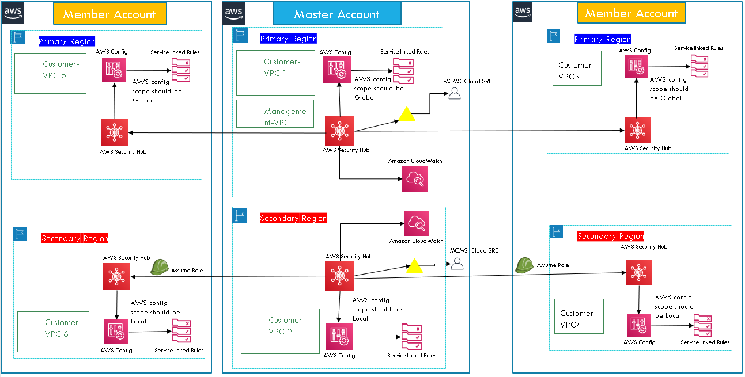
Use Case 3 : Multi-Account , Multi-Region Deployment

Slide 26
Multi-Account Multi Region Deployment
Adding a member account is a three step process - Add an account from the master account - Invite the added account from Master - Accept the invite from member account
When the invited account accepts the invitation, permission is granted to the master account to view the findings from the member account.
The master account can also perform actions on findings in a member account.
An account cannot be both a Security Hub master account and a member account at the same time. An account can accept only one membership invitation
If your account is the master account, you can't accept an invitation to become a member account.
We can monitor findings from multiple member accounts in master accounts region, but can't view the findings across regions in an account
pre-existing role in the master account and all of the member accounts that will be linked, the role name must be the same in all accounts and the role trust relationship needs to allow your instance or local credentials to assume the role

Slide 27
Cost Analysis
SH Security checks (US East) | Security Hub Pricing
First 100,000 checks/account/region/month | $0.0010 per check
Next 400,000 checks/account/region/month | $0.0008 per check
Over 500,000 checks/account/region/month | $0.0005 per check
Example :
Environment:
2 regions, 20 accounts ; 10000 security checks per account/region/month Total Cost: 10000* $0.0010 * 2 * 20 (first 100,000 checks/account/region/month) = 400$
* AWS cloud watch cost is within free tier pricing

Slide 28


Slide 29
Demo Setup
Master Account | 802878444238
Member Account | 968820898355
Primary region | Oregon
Secondary Region | North California
Primary Region -- This region will be scanning global resources against CIS benchmarks. Secondary regions will not be recording global resources configuration( IAM etc. ) . Production region would be the best candidate for Primary region for security hub.
Master Account -- If AWS Organisations is being used, AWS organization’s master account would be the best candidate for master Account in Security hub.

Slide 30
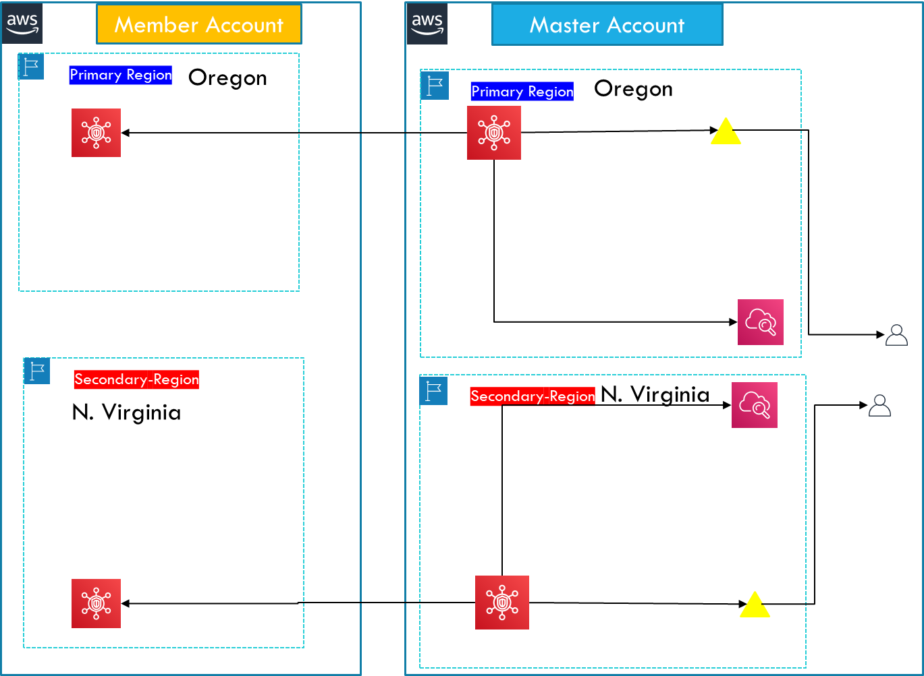
Demo Overview
Points to cover
Configure security hub for Oregon region – Master Account
Configure security hub for N.California region – Master Account
Security Hub for member account is already configured.
Link member account to Master Account for Oregon region .
Look and Feel security Hub dashboard.
Exploring security hub integration via cloudwatch.
N. California
N. California

